Slide 1
NOTES APPLICATION
(Create, View, Delete Notes stored in Files)
B.TECH ECE FIRST YEAR
PRAGATI ENGNEERING COLLEGE

Slide 2

INTRODUCTION
The Notes application is a C-based project designed to create, store, view, and delete notes efficiently . It allows users to manage their notes by storing them in files for persistent storage
Key Features:
Create new notes with title and content
View all stored notes from files
Delete notes by selecting from list
File-based persistent storage

Slide 3

Objectives of the project
To understand file handling in C
To perform Create, Read, and Delete operations
To store data permanently using files
To learn error handling
To implement file handling concepts
To develop a menu-driven program
To understand persistent data storage
To perform CRUD operations

Slide 4

Main Uses :
Personal Note Storage
Academic Purposes
Learning File Handling in C
Data Management
Mini Project Development
Application Areas:
Educational Institutions
Personal Computers
Office Environment
Embedded and Low-Memory Systems
Software Learning & Training

Slide 5
FLOWCHART
START
Create View Delete Exit
Menu:
Create/View/Delete
Choice?
File operations

Slide 6

Data Types used in the Project:
Int (Integer)
Char (Character)
Char[] (Character Array/String)
Struct (Structure)
File(File Pointer)
Void(Function Return Type)

Slide 7
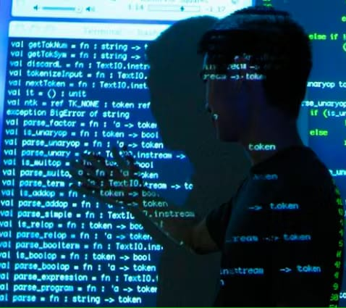
How These Datatypes Used In The Project
Int (Integer)
Stores numeric values such as
Menu choices
Note ID or note number
Loop counters
File position indicators
Relation to code:
Int choice;
Int note_id;
Char(Character)
Stores single characters or strings (using arrays)
Used for note content,titles,and filenames

Slide 8

Relation to code:
char title[50];
char content[500];
char filename[20];
Char[](Character Array/String)
Stores text data(notes are text-based)
Relation to code:
char note[1000];
Struct(Structure)
Groups related data of a note into one unit
Relation to code:
Struct note{
int id;
char tiltle[50];
char content[500];
};

Slide 9
File(File pointer)
Handles file operations
Relation to code:
FILE *fp;
Void (Function Return Type)
Used when a function does not return any value
Return to code:
void createnote ();
void viewnotes ();
void deletenote ();

Slide 10
CONCLUSION
The notes application provides an efficient and structed way to create ,store ,view, and delete notes using file-based persistent storage. The application demonstrates fundamental c programming concepts including file handling ,structures , and user input/output. It showcases how basic C programming concepts can be applied to build practical applications and improves understanding of file operations and modular programming.

Slide 11
THANK YOU
TEAM MEMBERS
Yedida Joshnika Sudha Rani : 25A31A04F9
Sarella Chandrahas : 25A31A04J0
Varri Vishnu Vardhan : 25A31A04J1
Vedula Venkata Sai Abhiram : 25A31A04J2
Yedla Sanjay Rahul : 25A31A04J3

